Slide 1
Defining and Using Functions
A supplemental lesson for AP CSP

Slide 2
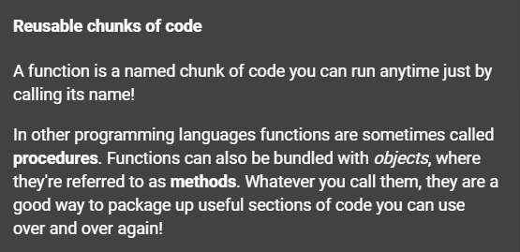
What is a function?
Function: a named set of instructions that accomplishes a task

Slide 3
What is a function?
Function: a named set of instructions that accomplishes a task
A function is a form of procedural abstraction.
Abstraction: the process of taking away or removing characteristics from something in order to reduce it to a set of essential characteristics
What this means is that you give a task a name. Then you don’t have to worry about the details of the task, but on the task itself and when to use it.

Slide 4

What is abstraction?
Source: Code.org CodeBreak 11.0 with Hadi Pavarti & Susan Wojcicki
Notes:
Link to youtube video: https://youtu.be/YjTynTwrcxA

Slide 5


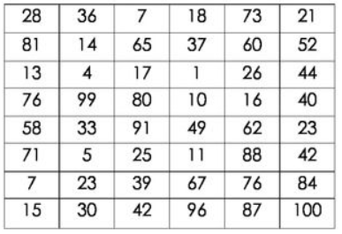
Examples of abstraction
Wash the dishes
You don’t have to be told every step for this task, which is the underlying details. The task has a name and you know what to do.
Turn left when driving
You don’t need to know how the car is turned when you use the steering wheel. The details are hidden but you can still drive the car.
Select the highest number
There are many ways to find the highest number in a list. You don’t need to see the details of how it is done, just that when you complete the task the highest number will be found.

Slide 6

A function is abstraction
A section or block of code accomplishes a specific task
Give the block of code a name
  This “hides” the details
  Focus on when to use the block of code
Instead of writing all the code, a programmer calls the function by name
The function can be called multiple times in a program

Slide 7
A function is abstraction
A function may be created to
  simplify code
  eliminate duplicate code
  make a section of code adaptable and flexible

Slide 8
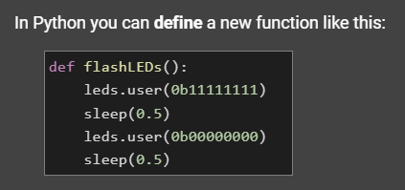
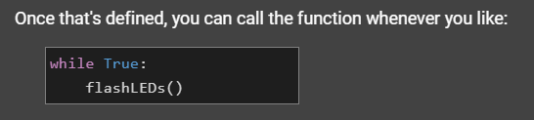
A function in Python

Slide 9
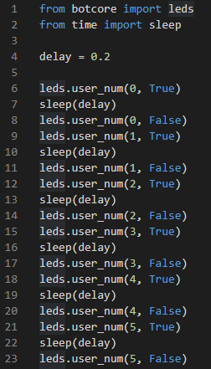
Example #1: defining and calling functions in SequenceLEDs
Go to the sandbox.
Open your SequenceLEDs code.
It will probably be similar to this, but it may be different.
Save the code with a new name, so you keep the original code (use Save-As):
SequenceLEDs_functions

Slide 10
Example #1: defining and calling functions in SequenceLEDs
Look through your code and find sections that could be a function.
Write now the order of the lights is hard-coded and cannot easily be changed.
If each light is a function, you can call them in any order!

Slide 11
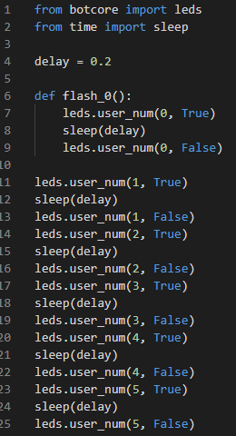
Define a function
Define function for flashing light 0
Functions typically are coded near the top of the program, just under imports and variables
A function definition ends with a colon (:) – you are creating a block of code
Don’t forget to indent! – the shortcut for this is to highlight the text and press TAB

Slide 12
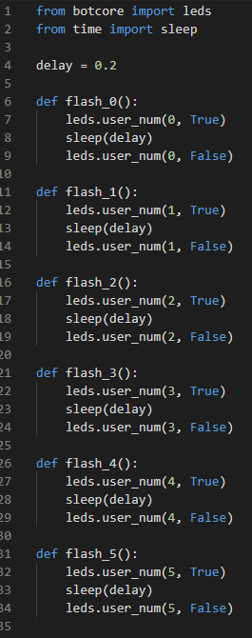
Define a function
Define more functions, one for each flashing light.
Remember the colon (:) and indenting for each function.
Each function has to have its own unique name.
All your code should now be in functions.

Slide 13
Call a function
Now you have functions for each task (flashing lights)
If you run your code, nothing will happen
– try it!
WHY??

Slide 14
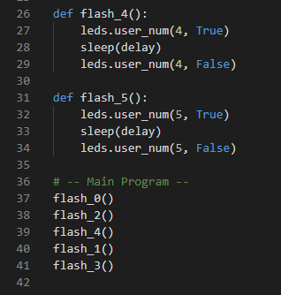
Call a function
All of the code is in functions.
Functions have to be called in order for their instructions to run.
This is typically done at the end of program code.
The great thing about functions is you can call them multiple times and in any order.
Here is one example of calling functions:

Slide 15
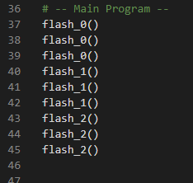
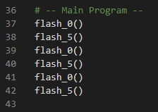
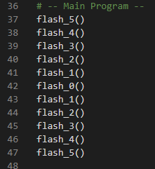
Call a function
Here are more examples:
With functions, you can repeat tasks, like flashing lights, without retyping the code.
You can call the functions in any order, as often as you want!

Slide 16
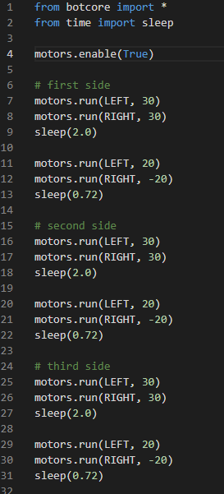
Example #2: functions in NavSquare
Open your NavSquare code.
It may look like similar to this, but it could be different.
Do you see the same code being used over and over again?
Save the code with a new name, so you keep the original code (use Save-As):
NavSquare_functions

Slide 17
Example #2: NavSquare
Some code is used for going straight.
Some code is used for turning.
The instructions are used four times each to form a square.

Slide 18
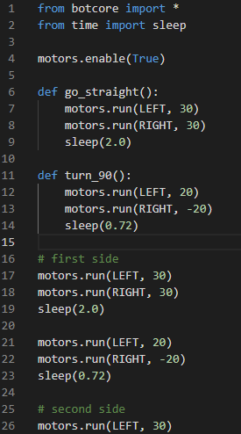
Example #2: NavSquare
Create two functions:
  One for going straight
  One for turning
Each function name should be descriptive of its task.
Remember the colon (:) and indenting!

Slide 19
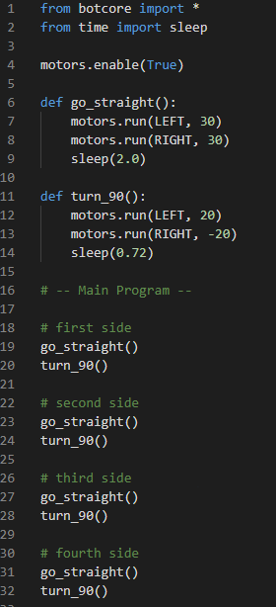
Example #2: NavSquare
Now replace all the code in the main program with function calls.
If you want to make the square a different size, you only have to change the function go_straight()instead of every time CodeBot moves along a side.

Slide 20
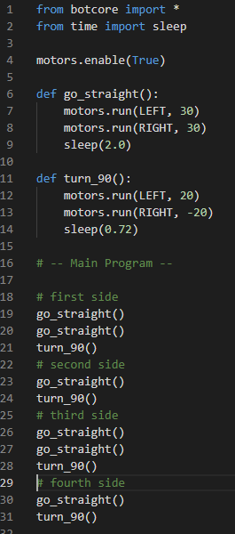
Example #2: NavSquare
You can also call the functions in any order.
Maybe you want to make a rectangle instead of a square.
Functions simplify code and give you a lot of flexibility as a programmer.
Making changes to code is also much easier.

Slide 21
Challenge
Another program you created in Mission 3 is BinaryLEDs
For a challenge, create at least one function for this program.

Slide 22
Wrap-up
Abstraction and Functions
Submit your two programs to the teacher:
SequenceLEDs_functions
NavSquare_functions

Slide 23
Answer these questions:
In your own words, what is abstraction?
Give your own example of abstraction:
In your own words, what is a function?
When should you create a function?
What must you do to execute (or run) code in a function?
Give two benefits of using functions:

